Slide 1
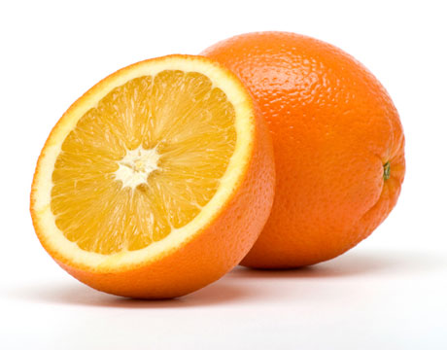
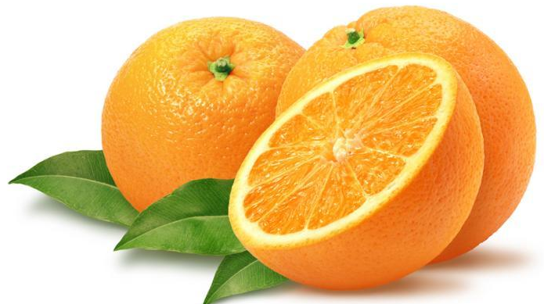
Countable nouns
Things I can count
Two oranges
Three oranges

Slide 2
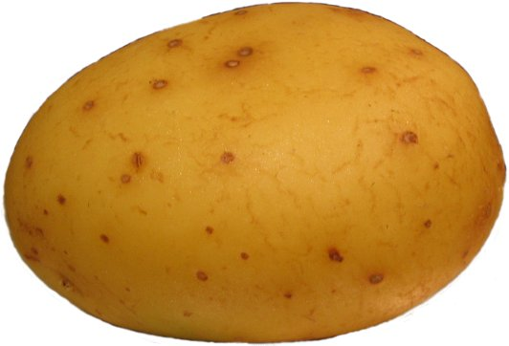
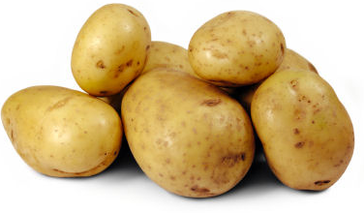
COUNTABLE NOUNS
SINGULAR:
a + noun
one + noun
PLURAL:
noun + -s
a potato
potatoes

Slide 3
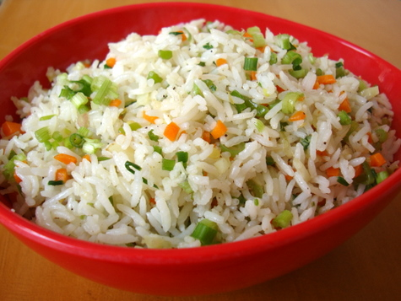
Uncountable nouns
Things I can’t count

Slide 4

NOUN
?
We love to read books.
?
countable
Uncountable

Slide 5
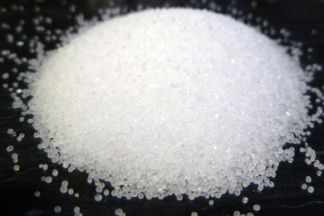
7-1 Let’s Practice
NOUN
?
Please pass the salt.
?
countable
Uncountable

Slide 6
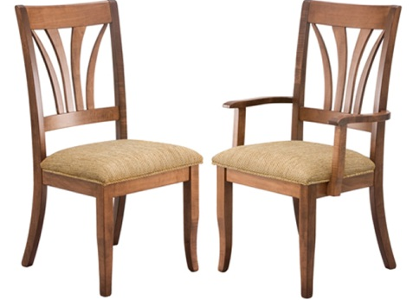
7-1 Let’s Practice
NOUN
?
We need some chairs.
?
countable
Uncountable

Slide 7
There is a mango.
I have an egg.
There are some apples.
I have some eggs.
There is some sugar.
He has some bread.
Singular countable
Plural countable
Uncountable

Slide 8
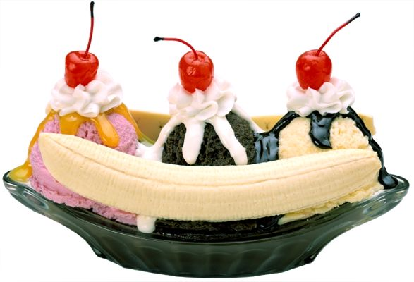
7-3 Let’s Practice
a an some
There is _____ banana in the recipe.
a
singular countable noun

Slide 9
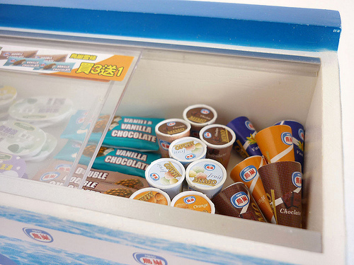
7-3 Let’s Practice
a an some
There is _____ ice cream in the fridge.
some
uncountable noun

Slide 10

7-3 Let’s Practice
a an some
I need _____ water to wash my hands.
some
uncountable noun

Slide 11
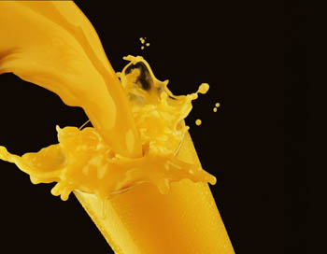
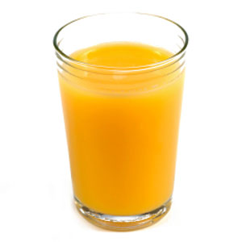
I’d like some juice.
I’d like a glass of juice.
unspecified quantity
specified quantity

Slide 12
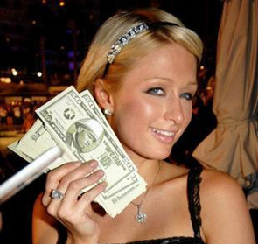
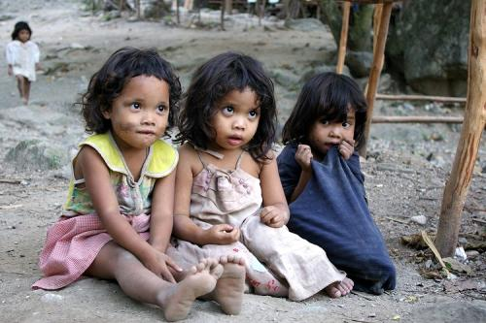
Some: Affirmative sentences:
There is some money
Any: Negative and Interrogative sentences:
Is there any money?
No, there isn’t.
There isn’t any money

Slide 13

7-8 Let’s Practice
some any
I need _____ time to study.
some

Slide 14
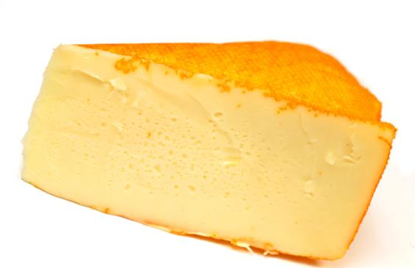
7-8 Let’s Practice
some any
There is _____ cheese.
some

Slide 15
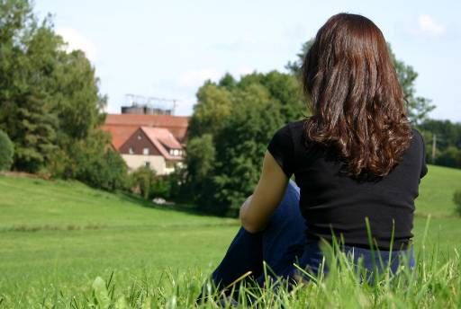
7-8 Let’s Practice
some any
There aren’t _____ horses in the field.
any

Slide 16

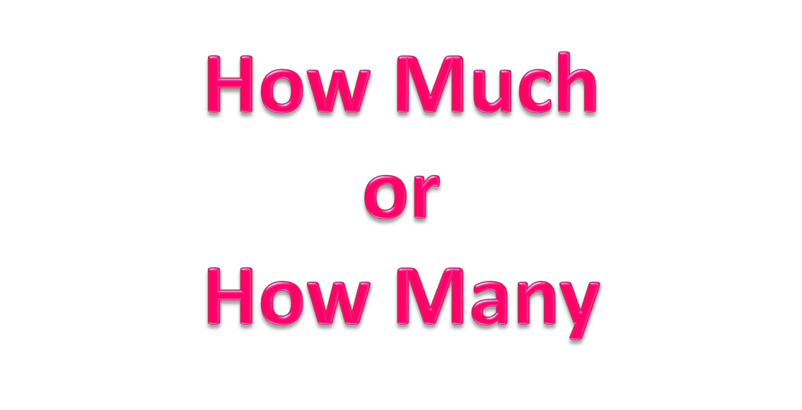

Slide 17
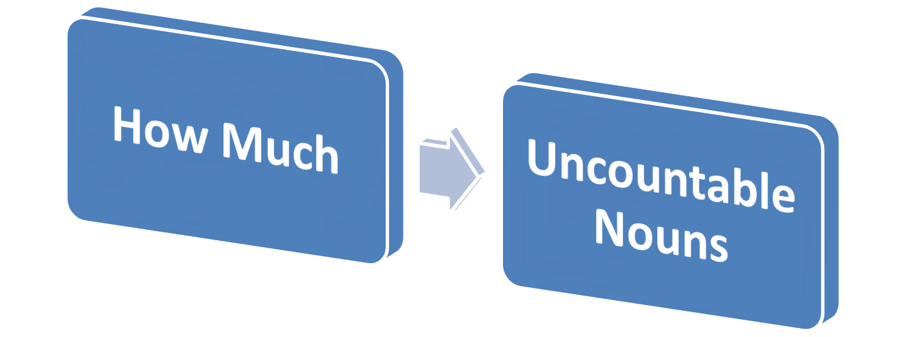
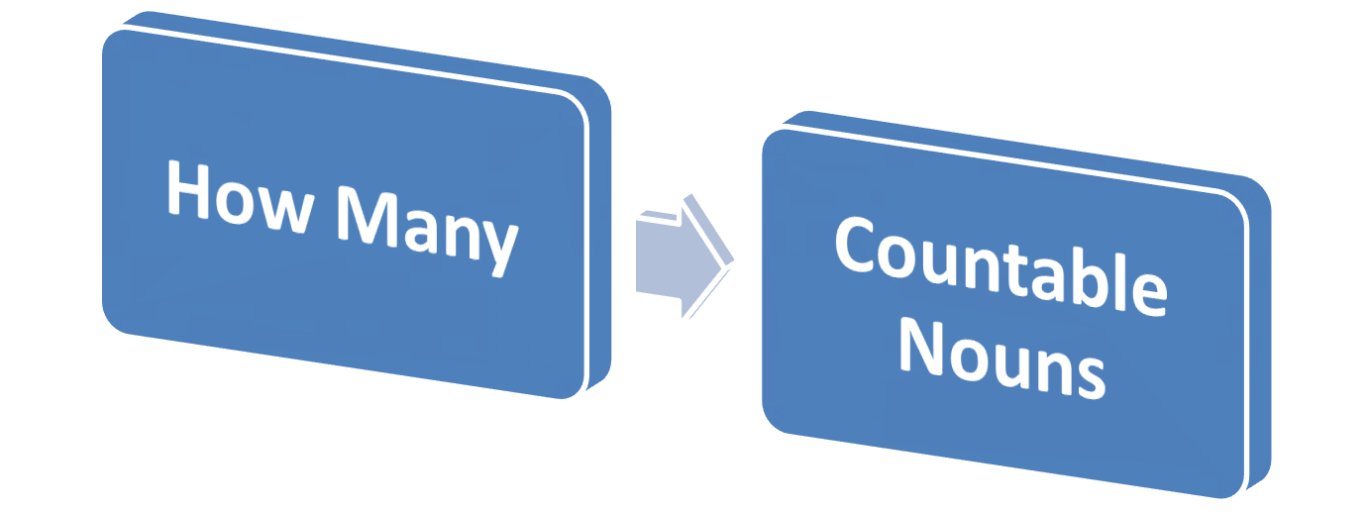

Slide 18
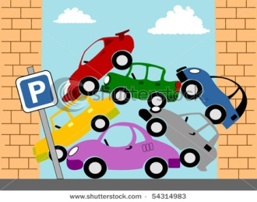
How Many or How Much ?
How much/ How many cars are there?
There are six cars!

Slide 19
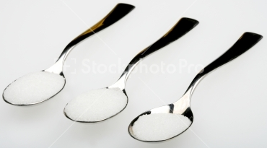
2. How much/ How many Sugar is there?
There are three spoons of sugar

Slide 20

3. How much/ How many pictures are there?
There are six pictures.

Slide 21
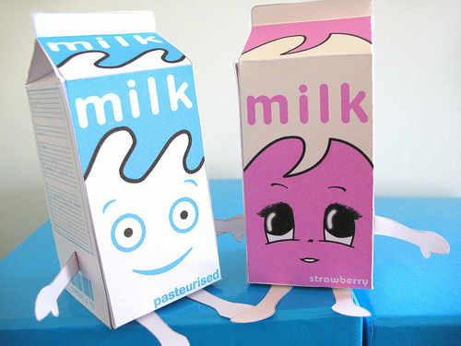
4. How much/ How many milk is there?
There are two boxes of milk

Slide 22
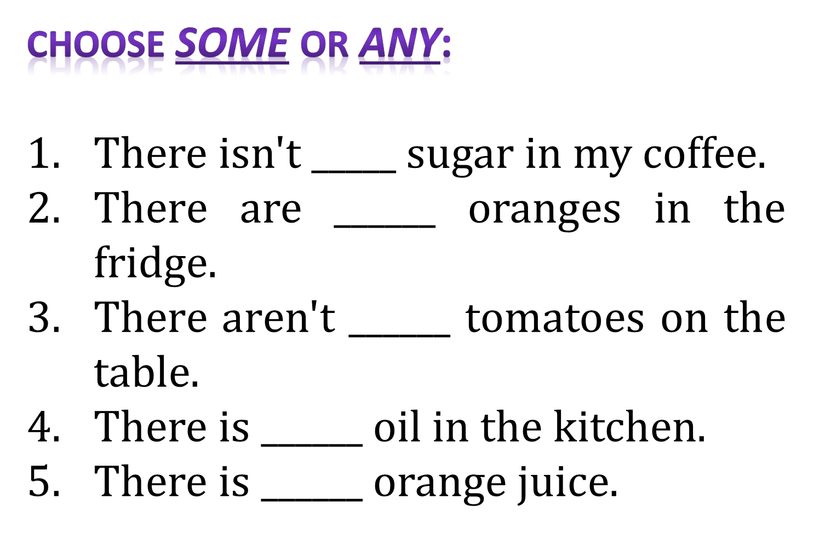

Slide 23
